Slide 1

Spectrum and Network Slicing Attacks
Vulnerability, Threat Vectors, and Mitigation
Video 7.5

Slide 2
Spectrum Attacks
5G Radio Frequencies
Jamming Deliberate radio frequency interference to degrade or prevent service.
Sniffing Gain intelligence and insight into mobile network configuration or set-up.
Spoofing Make fake signals or communication seam real.

Slide 3
Jamming and Mitigation
Attacker has to decode parameters for channel assignments.
Very complex and difficult in higher bandwidths.
More likely in lower bandwidths, below 6 GHz.
Mitigation
Use Machine Learning and Artificial Intelligence.
Randomize channel usage.
Leverage beamforming and Dynamic Spread Spectrum (DSS).
Utilizes Hardware Security Module (HSM) – needs tight security!
Notes:
3GPP TS 23.003

Slide 4

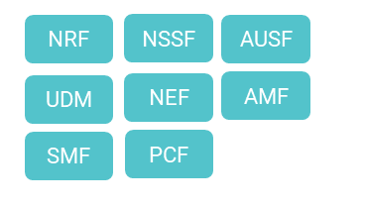


Network Slicing
Slice A:
Low Latency,
High Bandwidth,
High Capacity
Slice B:
Moderate Latency,
Low Bandwidth,
High Capacity

Slide 5
Network Slicing Threats
Adaptive Mobile research gaps found.
Location tracking.
Denial of Service.
Unauthorized access to network function in another slice.
Mitigation
Secure perimeter around a network slice.
Review configuration and run security tests.
5G standalone networks still evolving.
Notes:
3GPP TS 23.003

Slide 6
Key Takeaways
01
Spectrum Attacks are Possible
Less viable, especially higher frequencies.
02
Network Slicing Vulnerabilities Exist
Set a secure perimeter around slices.
03
Evolution of 5G Still Underway
Security in network slicing will be a focus.

Slide 7
Policies and Standards, Supply Chain, and Architecture
Next Video

